Slide 1
Group 4
Automobile Sector
Group Members:
Aditya Saboo (04)
Dheer Ved (14)
Jatin sharma (24)
Lavish Mittal (34)
Priyanka (44)
Sanket Vangule (54)
Vaishnavi Bhamre (64)

Slide 2
Nature of Products
In economics, goods are classified into several categories based on different criteria such as Substitute Goods; Inferior Goods, Normal goods, Luxury goods, Veblen goods, Giffen goods etc.
4 Wheelers mainly come under normal and luxurious products.
One of the main key factor, where nature of product is decided is price range. The automotive market offers a wide range of price points, from affordable economy cars to luxury and high-performance vehicles.

Slide 3
Normal goods:
A normal good is a good that experiences an increase in demand due to an increase in a consumer's income.
Mid-Range Sedans: Vehicles like the Honda City, Maruti Suzuki Ciaz, and Maruti Suzuki Swift Dzire, are often considered normal goods. They offer a balance between affordability and features, making them attractive to a broad range of consumers.(Price range- 10-15 lakhs)
Compact Cars: Models such as Renault Kwid, Tata Tiago, and Maruti Suzuki WagonR are often purchased by consumers across different income levels due to their affordability, fuel efficiency, and practicality.(5-10 Lakhs)
Crossovers Hyundai Creta, Maruti Suzuki Brezza, Tata Nexon, and Kia Seltos considered normal goods because they offer versatility, space, and comfort, appealing to a wide range of consumers(15-22 Lakhs)

Slide 4
Luxury goods:
Luxury products are high-end, premium vehicles that are known for their superior quality, performance, advanced technology, comfort, and prestige.
The Mercedes-Benz S-Class -The Mercedes-Benz S-Class is renowned for its opulent interior, cutting-edge technology, and a smooth, comfortable ride.(2Cr-3Cr)
BMW 7 Series-BMW's flagship sedan, the 7 Series, offers a combination of luxury, performance, and advanced features.(1.70-2.30Cr)
Audi A8 -The Audi A8 is known for its elegant design, sophisticated technology, and a plush interior.(1.34-1.63 Cr)

Slide 5
Demand Curve for the Automobile sector in India
DEMAND SCENERIO
Price ( Per Unit )
a
Pa
D
0
Qa
A Demand curve for Automobile sector (Passenger Vehicles) is downward slopping from left to right. Showing the inverse relationship between the price of Vehicles and quantity demanded over a period of time.
Quantity demanded ( Per Unit of time)

Slide 6
Factors affecting the demand for PV Industry.
Income of the consumer
Rising fuel prices
Rise in raw material and production costs
Growth of public transport in metros and major cities
Adoption of EVs
Shifts in demand curve due to changes in variables other than price
Price ( Per Unit )
a
D1
D
D2
0
Q2
Qa
Q1
Quantity demanded ( Per Unit of time)

Slide 7
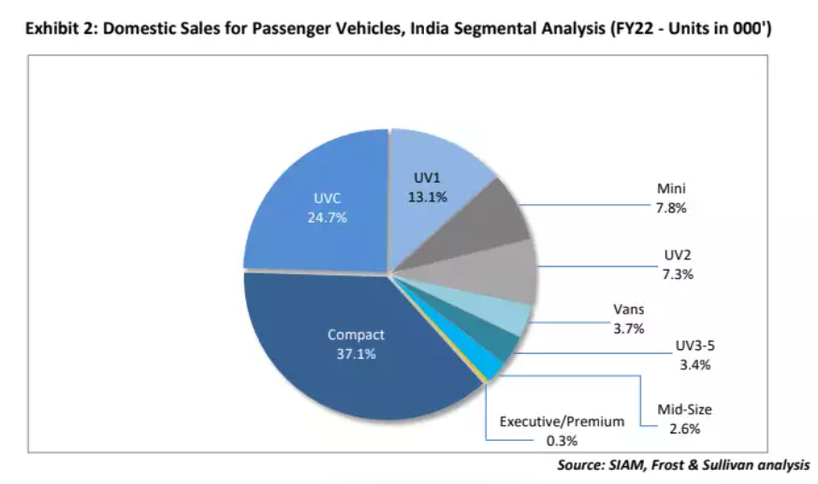
Segment Wise analysis of % of domestic sales for passenger vehicles:
Compact hatchbacks dominating sales
Decrease in sales of Mini segment
Increasing affordability of compact and mid-size SUVs is limiting the opportunity for mid-size segment growth

Slide 8
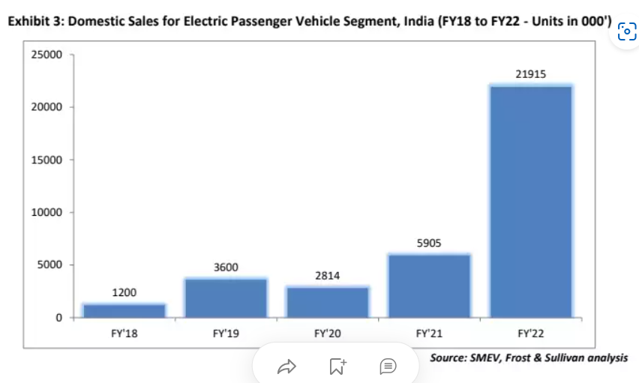
Electric Passenger Vehicle Segment
Fuel efficient
High performance
Low emission Vehicles
Stringent govt rules
Regulation towards vehicle emission along with reduction in cost of electric vehicle batteries
Increasing fuel costs

Slide 9
Supply Curve for the Automobile sector in India
Price
S
A supply curve shows how quantity supplied will change as the price rises and falls.
A supply curve shows the minimum price a firm will accept to produce a given quantity of output.
P1
S
Q1
Quantity
Sample Supply Curve

Slide 10
Supply Chain Management
Raw Materials Supplier
Tier 1 Suppliers
OEMs
Dealer’s Network
Logistics and Transportation
Inventory Management
Customer Orders
After-Sales Services
The supply chain of 4-wheeler vehicles in India is a complex and multi-tiered process.
These factors interact in complex ways and their supply of 4 wheelers cars in India can vary over time.
Car Manufacturers closely monitor these factors to make informed decisions.

Slide 11
Passenger Vehicles Sales
(In terms of number of cars)
Company | H1FY24 | H1FY23 | % Growth
Maruti and Suzuki | 873107 | 794550 | 10%
Hyundai | 307075 | 285005 | 8%
Tata Motors | 279389 | 273135 | 2%
Mahindra | 214914 | 168723 | 27%
Toyota | 114791 | 91433 | 26%
Honda | 37658 | 47163 | -20%
MG | 28882 | 22164 | 30%

Slide 12
Factors affecting the Supply for PV Industry.
Price
Production Capacity
Government Policies and Regulations
Economic Conditions
Consumer Preference and Latest Trends
Wide Dealer Network and Inventory Management
S2
S
S1
Decrease in Supply
Increase in Supply
Quantity

Slide 13
Elasticity
Elasticity is the responsiveness in change in one variable due to change in another variable.
Types of elasticity:
Price Elasticity Of Demand
Cross Price Elasticity Of Demand
Income Elasticity Of Demand

Slide 14
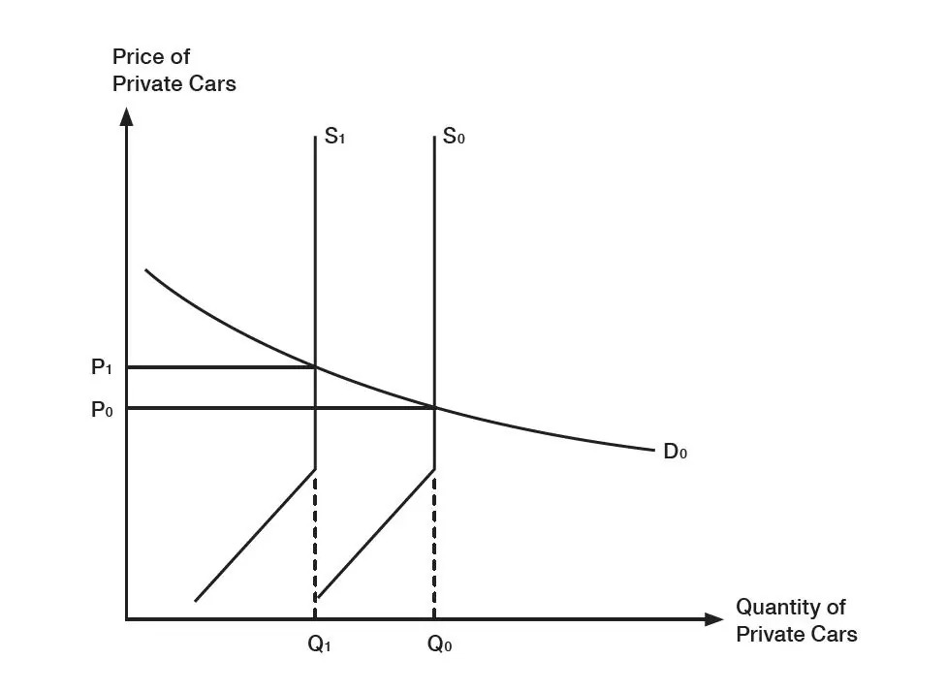
Elasticity in Automobile sector
The price elasticity of demand in automobile sector is greater than 1 in India. This means that the proportion in change in demand of an automobile will be greater than the proportion in change in of its price .
Price Elasticity of Cars in India (2014-15)
Make | Model | Segment | Qs in 2015 | % Delta Q | Price in 2014* | Price in 2015 | % Delta P | Price Elasticity (Ep)
Maruti | Alto | A | 21462 | -6.2 | 2.68 | 3.01 | 12.31 | 0.5
Maruti | Dzire | C1 | 17587 | -10 | 5.1 | 5.1 | 0.78 | 12.75
Maruti | Swift | B2 | 14057 | -29 | 4.5 | 4.9 | 8.88 | 3.2
Maruti | WagonR | B1 | 12744 | -0.9 | Nil | 4.69 | 14.39 | 0.06
Maruti | Baleno | B2 | 7698 | 0 | 4.28 | 7.47 | Nil | Nil
Maruti | Celerio | B1 | 7141 | 48 | 2.7 | 4.5 | 5.14 | 9.33
Maruti | Omni | Utility | 5901 | -1.8 | 6 | 2.34 | 13.33 | 0.13
Maruti | Ertiga | Utility | 5799 | -3.9 | 8.5 | 6.18 | 3 | 1.3
Maruti | Ciaz | B2 | 5431 | -9.6 | 3.6 | 10.19 | 19.88 | 0.48
% change in demand
% change in quantity
Price elasticity of demand =

Slide 15
Cross Price elasticity in the automobile industry is high. When the price of petrol and diesel increases in the market it leads to decrease in the quantity demanded of the automobile. Hence, the cross-price elasticity shall be less than 0 (negative), as the two goods are complementary goods.
Change in quantity demand of X
Change in Price of Y
Cross price elasticity of demand =
(X & Y can be complimentary or substitute goods)

Slide 16
Income elasticity of demand for automobile industry is greater than 1. When the income for a segment or any particular individual goes up they tend to buy the luxury items (EMI).
% change in quantity demand
% change in Income
Income elasticity of demand =

Slide 17
Elasticity of Luxury Cars
The elasticity of luxury cars will be inelastic, because the ones who want to buy the cars of those segments will buy them eventually, without getting affected by the price range.

Slide 18
Why is the Indian Automobile Sector Oligopolistic in Nature
MARKET STRUCTURE
Few Dominant Players
Interdependence
Barriers to entry
Product Differentiation
Price Makers

Slide 19

Economic Profit or Loss in the Automobile Industry

Slide 20
CONTRIBUTION IN GDP
Adds 7.5% to the GDP & 49% to India's manufacturing GDP.
The contribution to the National GDP increased -7.1% to 2.77% in 1992-93.
Employment to over 19 million people.

Slide 21
EXPORTS
Passenger car sales dominated by small and midsized cars.
Export increased from 4,134,047 in 2020-21 to 5,617,246 in 2021-22. (+ 35.9%)
2019 - 4.5 million vehicles sold in the country.

Slide 22
2020 the number dropped by about 3 %.
2021 vehicles produced rose by 30% compared to 2020.
April to December 2021, exports were 424,037 units, up from 291,170 units from April to December 2020.

Slide 23
Automotive Market was valued at USD 100 billion in 2021
Expected to reach USD 160 billion in 2027
Registering a CAGR of 8.1% over the forecast period (2022-2027).

Slide 24
Economic performance influenced by various factors:
Economic conditions: The higher GDP leads to higher volume of automobile sales.
Consumer demand: Supply and demand have direct proportionality and are critical in the economy’s growth.

Slide 25
Government policies: Minor changes in the basic custom duties, cesses and surcharges.
Global market trends: Connectivity of vehicles are some of the key mobility trends affecting the automotive industry its stakeholders.

Slide 26
Government regulations

Slide 27
Effects of regulations on supply and demand
Supply
Vehicle safety standards
Emission standards
Foreign investment regulations
2. Demand
Taxes and duties
Fuel prices
Loan interest rates
Government incentives

Slide 28
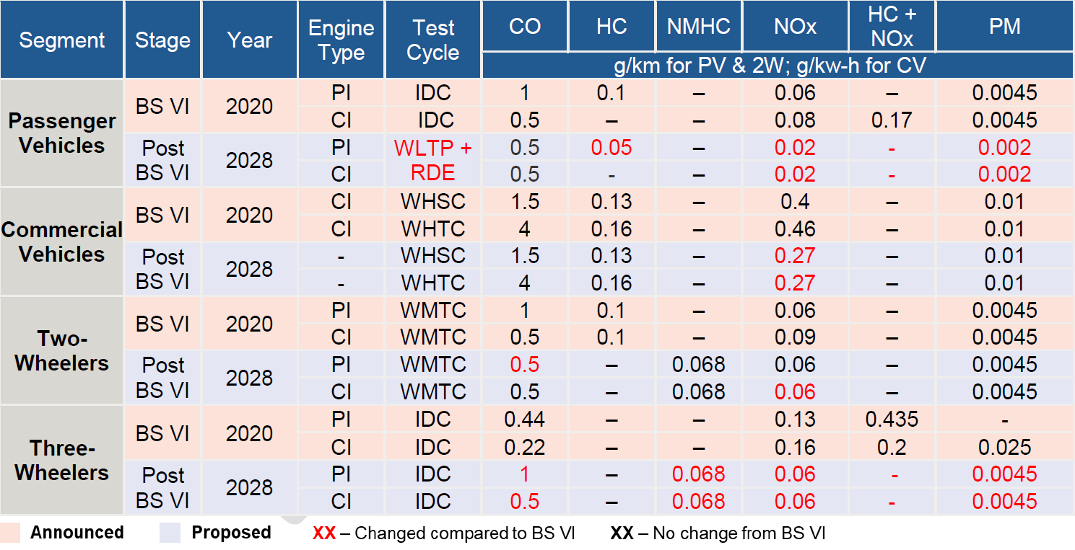
Emission Norms
BS IV and E15
BS VI and E20
The Problems
The alternatives

Slide 29
Safety Norms
New Mandatory Features
Safety regulations for EVs
Applications of safety features
Effects on the automobile industry
Challenges faced by the manufacturers

Slide 30
Taxes and import duties
The Make in India scheme
The effect of considering a car as a luxury
Up to a 100% duty on Imported luxury cars
Pre – GST vs. car GST

Slide 31
THANK YOU

